Slide 1

KKBox Churn Prediction Challenge https://www.kaggle.com/c/kkbox-churn-prediction-challenge/data
Beverly Rice
Springboard Capstone
January 2018

Slide 2

Overview
Client & Problem Set
Description of Data Set
Data Wrangling Steps
Exploratory Analysis
Model/Method
Results of Analysis
Recommendations for Client
Suggestions for Improvement

Slide 3

Client & Problem Set
KKBox: Asia’s leading music streaming service
40M tracks & over 10M subscribers from 6 countries
Supports Apple, Windows, Android, Symbian, Bada & Java
Offers personal recommendations, high-quality sound, exclusive live concerts & “Listen With” feature
“Freemium” business model; pay for additional features
Problem: Build algorithm to predict churn so that Kkbox may be proactive in keeping users

Slide 4
Data Set
Train_v2.csv
Cases: 970,960 members whose subscription ended Feb 2017
Variables: unique user ID & whether member churned
Members_v3.csv
Cases: 6,769,472 members not encompassing all in the train set
Variables: unique user ID, city, age, gender, registration method & registration initialization time
Transactions_v2.csv
Cases: 1,431,009 transactions dating up to March 31, 2017; many members completed multiple transactions
Variables: unique user ID, payment method, payment plan, plan price, amount paid, whether member opted to auto-renew subscription, transaction date, membership expiration date, and whether or not the member actively cancelled a given transaction

Slide 5
Data Set (cont)
User_logs_v2.csv
Cases: 18,396,362 daily user logs
Variables: unique user ID, date of log, number of songs played at less than 25% of the song length, between 25-50% of the song length, between 50-75% of the song length, between 75-98.5% of the song length, and over 98.5% of the song length; also includes number of unique songs listened to and total seconds played for the given log
Sample_submission_v2.csv
Test data set; list of users whose subsciprtion expires within the month of March 2017
Goal: predict whether these members will/will not churn

Slide 6
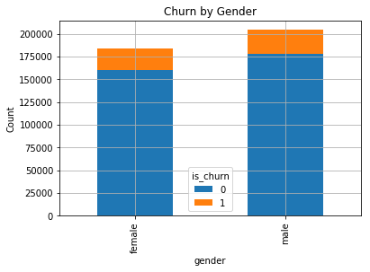
Data Wrangling
0. Conduct Exploratory Analysis & Create new variables
(detailed in later slides)
1. Merge train & members file
2. Investigate null variables
472,062 gender variables missing
860,967 cases
109,993 dropped
472,062 null variables
12.90%
Considering only 45% reported a gender and males/females churned at the same rate, the variable was discarded
12.98%

Slide 7
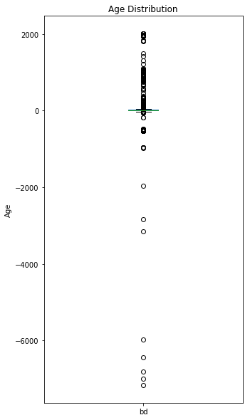
Data Wrangling (cont)
3. Investigate Outliers
Outliers identified in age variable
Ranged from -7168 to +2016
67% reported an age of ‘0’
Removed user < 1 and > 100
Most between ages of 15 & 55
Made up 30% of original data set
Variable discarded
4. Merge file with Transactions file
0 null variables and 0 outliers
Remove duplicates: sorted by user ID & membership expiration date & kept the last in sequence

Slide 8


Data Wrangling (cont)
Merge file with Logs file
0 null variables and 0 outliers
725,722 of those in the train set had at least 1 log file
Remove duplicates: sorted by user ID & latest log date & kept the last in sequence
Data set was relatively clean
Removed 2 & created 23 new variables

Slide 9
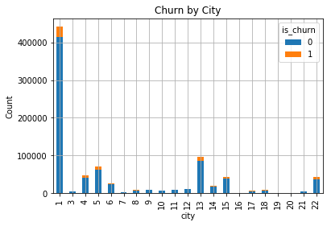
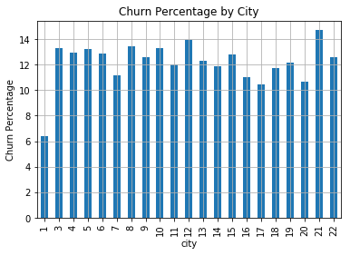
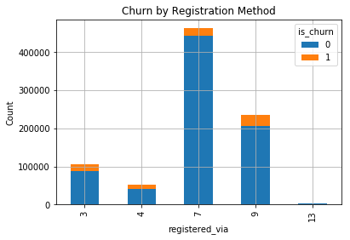
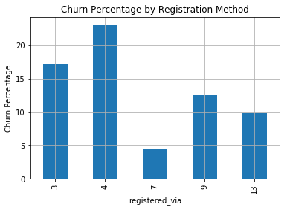
Exploratory Data Analysis

Slide 10
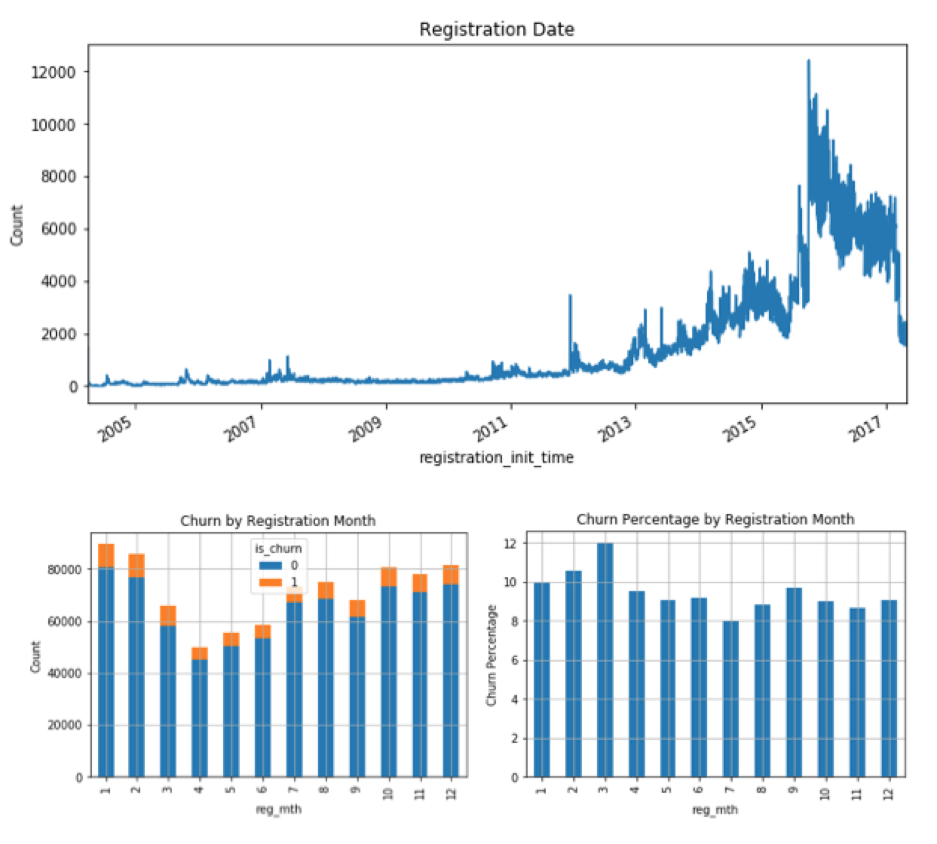
EDA (cont)

Slide 11
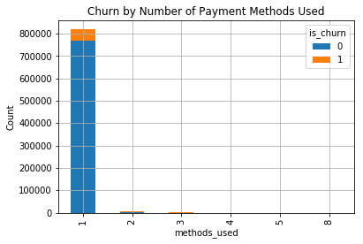
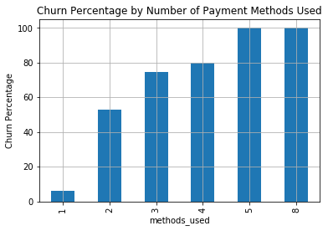
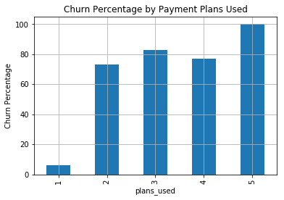
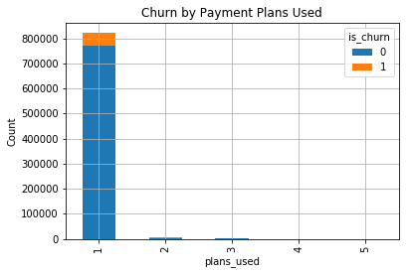
EDA (cont)

Slide 12
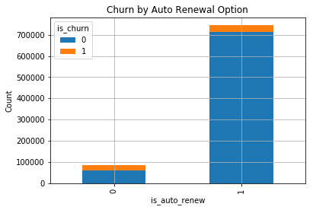
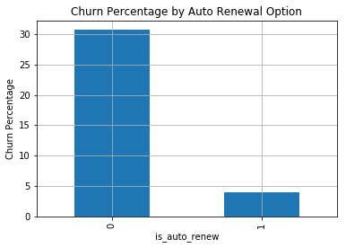
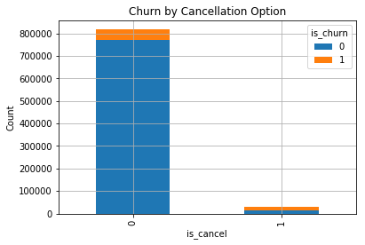
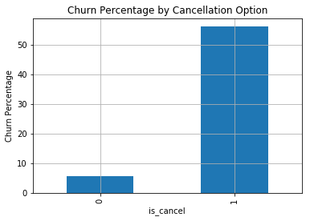
EDA (cont)

Slide 13
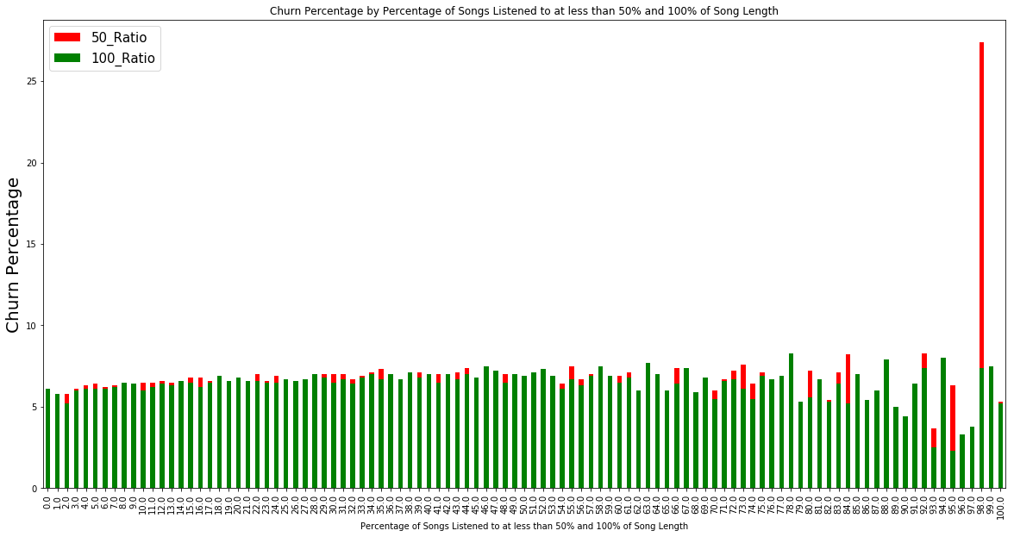
EDA (cont)
Churn Percentage by Percentage of Songs Listened to at less than 50% and 100% of Song Length
Percentage of Songs Listened to at less than 50% and 100% of Song Length

Slide 14
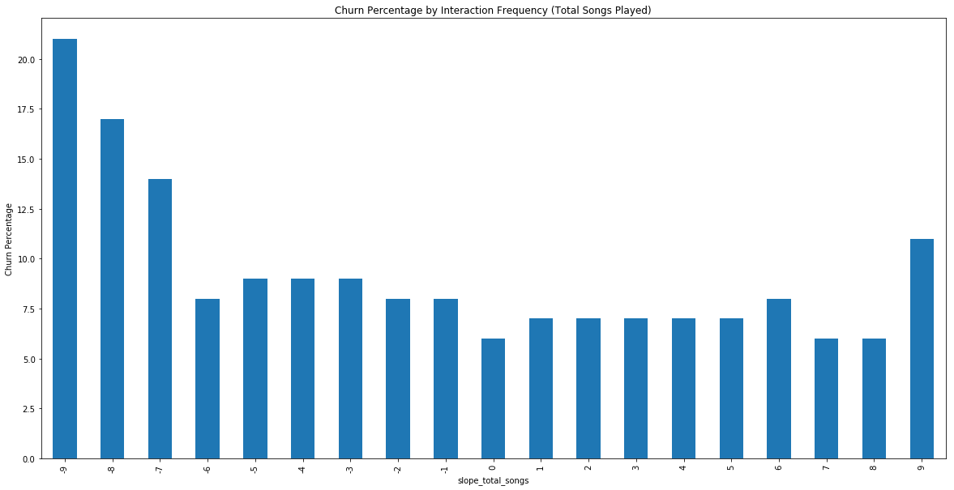
EDA (cont)
Churn Percentage by Interaction Frequency (Songs Played)
Interaction Frequency (slope)

Slide 15
Model/Method
Original Variables Used
Msno --- Label
Is_churn --- Independent Variable
City
Registered_via
Registration_init_time
Payment_method_id
Payment_plan_days
Plan_list_price
Actual_amount_paid
Is_auto_renew
Transaction_date
Membership_expire_date
Is_cancel
Date (log)
New Variables Used
Discount
Percent_off
Methods_used (payment)
Less_50, less_100
P_less_50, P_less_100
Repeated_songs
Plans_used
Avg_unq_songs
March_25/50/75/985/100
March_total_songs
March_total_secs
Total_secs_march
Mbr_time
Transaction_count
Log_count
Slope_total_songs
Slope_total_secs

Slide 16
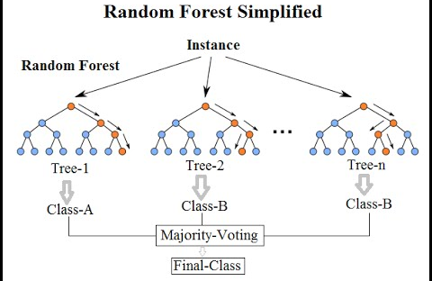
Model/Method
train_test_split = 0.20 & random_state = 0
Methods Used:
KNN – n_neighbors = 6 ---> 0.00% churn recall
Logistic Regression – max_iter = 100 ---> 20% churn recall
Random Forest Classifier – n_estimators = 10 ---> 74% churn recall

Slide 17
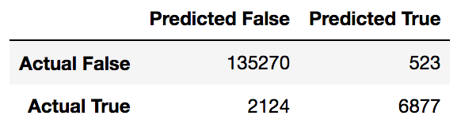
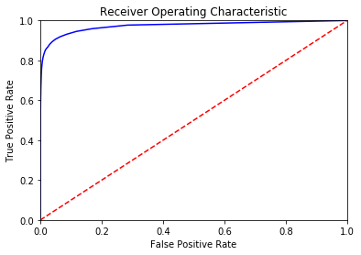
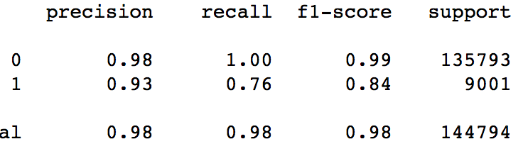
Model/Method
Random Forest Classifier
6877/9001 Churners accurately predicted
76% recall score
ROC Curve depicts the true positive rate in function of the false positive rate
88% Area Under Curve

Slide 18
Results of Analysis
Of the KNN, Logistic Regression, and Random Forest Classifier Models tested, the Random Forest Algorithm produced the best result by a wide margin
Most important features: membership expiration date, most recent transaction date, payment plan days, total transaction count, and whether the user actively cancelled their most recent subscription
Members who listened to a majority of their songs at less than their full length were more likely to churn than those who saw most of their songs through
Members who used multiple payment plans and methods were more likely to churn than those who used just 1
Members whose interaction frequency with the service remained constant throughout any given month are less likely to churn than those whose interaction frequency changed

Slide 19
Recommendations for KKBox
1. Look further into percentage of songs listened to at less than their full length; users who listened to a majority of their songs at 0-50% of the song length may not be receiving the best music recommendations from the service
2. Look into members displaying less frequent service interactions as a given month progresses; mid-month assessments may be helpful in identifying potential churners early on
3. Reduce payment plan lengths to less than 100 days and/or eliminate plans that cost over $300; payment plans lasting over 100 days and costing more than $300 showed near 100% churn rates

Slide 20

Suggestions for Improvement
For Model Improvement
1. Provide churn history beyond those who left in March 2017
2. Provide log files for the last year, not just for the month of March
3. Provide assessment on search and recommendation engines ideally by ability to cater to each individual user

Slide 21
Questions???

